Slide 1

Vehicle Object Tracking and Traffic Analysis
DATA 603 Platforms for Big Data Processing
Final Project Presentation
Sruthi Kapudasi
Harshitha Josyula
Usha Sai Kiran Uppala

Slide 2


Team Name
SPARK SQUAD

Slide 3
Table of Contents
Title and Introduction
Project Objectives
Data Sources and collection
Tools and Technologies
Reports, Insights, and Recommendations
Future Opportunities and/or Challenges
References
Technical Work

Slide 4
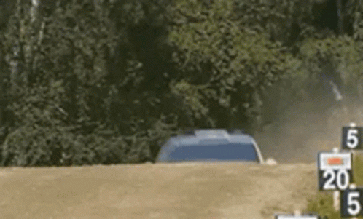
Introduction
The rise in traffic accidents globally necessitates data-driven approaches
to enhance road safety.
This project investigates patterns
in car crashes using a large dataset of
car crash images.
Combines big data technologies
and analytics for real-world impact.
By analyzing car crash patterns, we can:
Identify and track objects of interest within video frames.
Analyze vehicle behavior and interactions.

Slide 5
Introduction
This presentation delves into a comprehensive analysis of car crash data to identify key elements influencing accident rates. We will explore factors such as:
Ego Vehicle and Driver Behavior: An ego vehicle is a vehicle that has sensors that perceive its surroundings and is used in the context of automated driving.We explore if the Ego- Vehicle was involved in the accident.
Day vs. Night Crashes: The significant differences in crash patterns between day and night, analyzing visibility, traffic volume, and driving habits during different times.
Weather Conditions: How varying weather conditions, such as rain, snow, and clear skies, impact road safety and contribute to accident frequency.

Slide 6
Project Objectives
Analyze car crash patterns using big data tools.
Develop a system for visualizing crash metadata.
Generate actionable insights to inform traffic safety strategies.
Key Questions:
What trends can be observed in crash occurrences?
How do environmental conditions affect crash likelihood?

Slide 7
Data Sources and Collection
Data Source:
Kaggle dataset: Car Crash Dataset (CCD)
Data Collection:
Downloaded the dataset from Kaggle.
Highlight potential challenges:
75,000 images (8.59GB), 56 columns including video name, frames,id, timing(day/night),weather and ego involvement.
Each video has 50 frames captured at 10 frames per second.
The extracted features include metadata for object detection and accident analysis.
Data includes attributes like crash metadata, object IDs, and environmental details (e.g., day/night conditions and weather).

Slide 8






Tools and Technologies
Kaggle: Downloaded dataset.
MongoDB: Storing and managing video frames and metadata.
Apache Spark: Data processing and feature extraction.
Power BI: Visualization of insights and reports.
Notes:
MongoDB’s efficiency with unstructured data.
Spark’s distributed computing capabilities for handling large datasets.
Power BI’s user-friendly interface for visualizing insights.

Slide 9

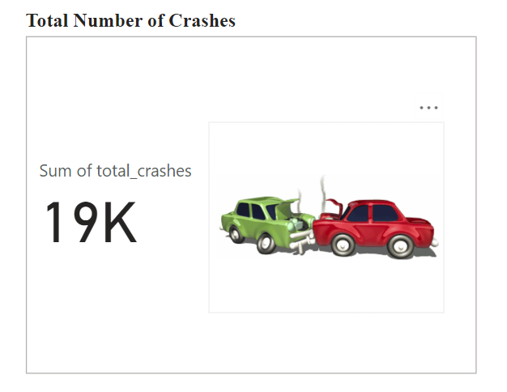
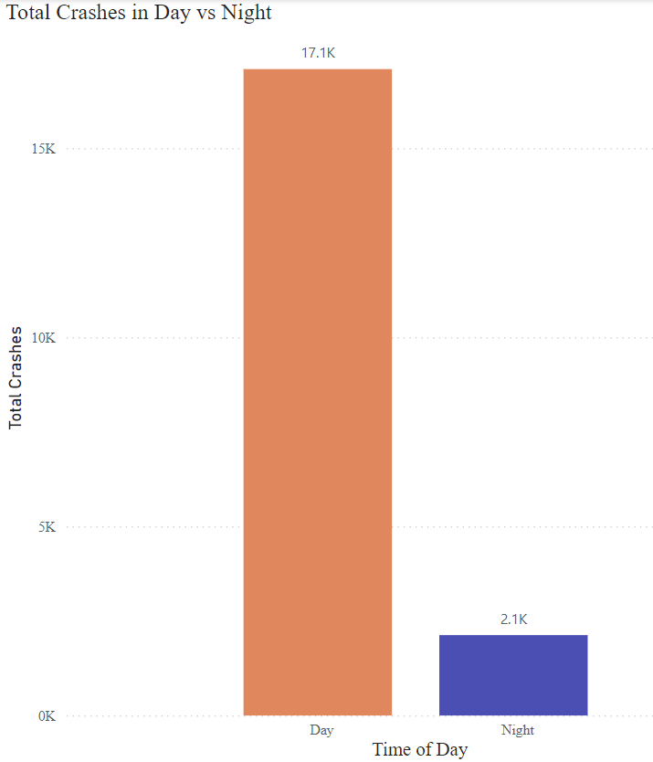
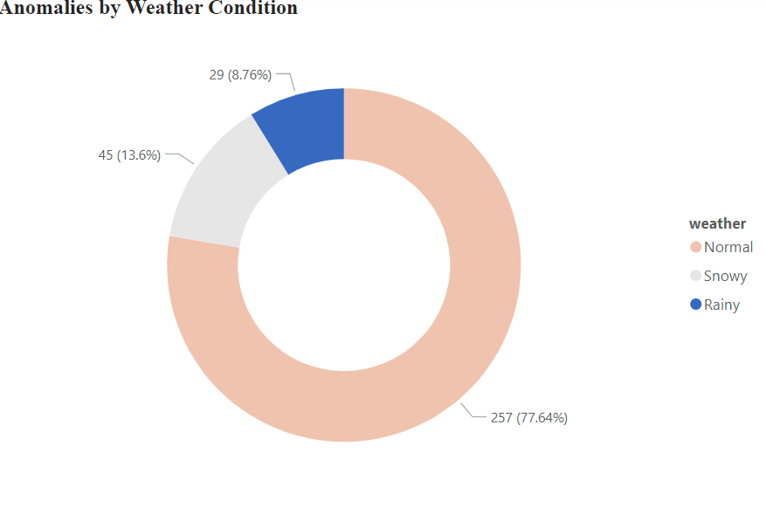
x
Reports,Insights and Recommendations
Recommendations:
Invest in smart lighting systems for roads.
Enhance public awareness campaigns about weather-related risks.

Slide 10
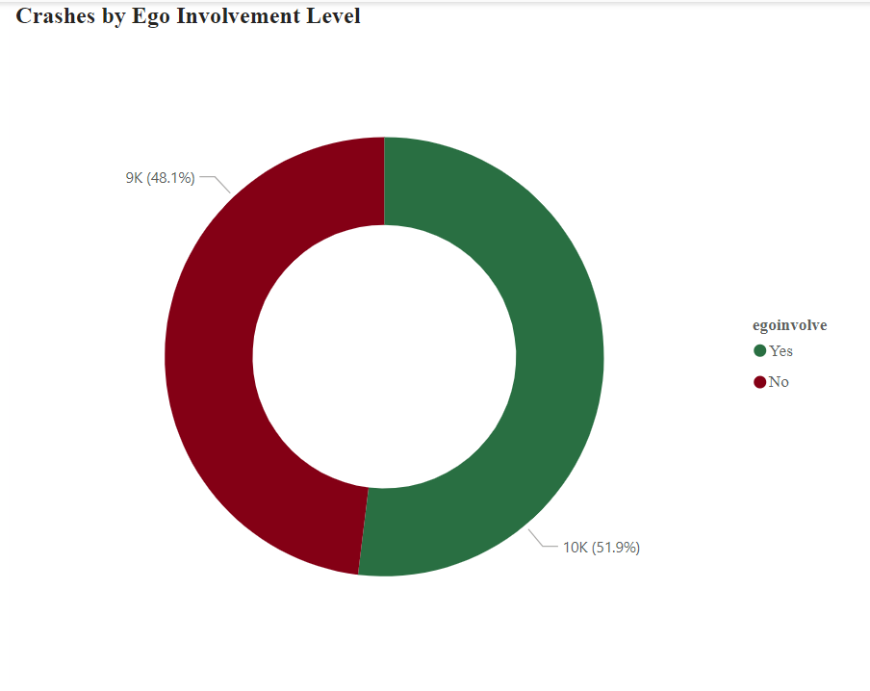
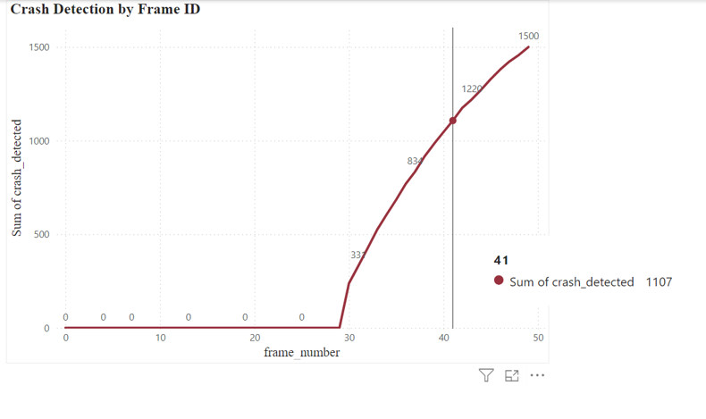
Reports,Insights and Recommendations
Improve the ego vehicle’s decision-making and object detection algorithms to minimize crash risks.

Slide 11
Suggestions for C-Level Executives to Improve ROI
Invest in AI-Powered Traffic Monitoring Systems
ROI: Reduces Accidents
Prioritize High Crash Zones
ROI: Improves Traffic flow and safety
Smart Road Lighting
ROI: Decreases Night time Crashes
Targeted Education Programs
ROI:Minimizes accidents caused by human error
Adopt Predictive Analytics
ROI: Optimizes resource allocation for traffic management

Slide 12

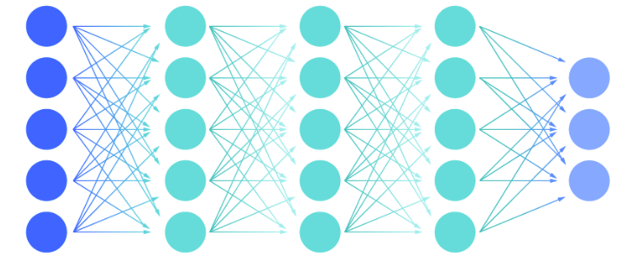
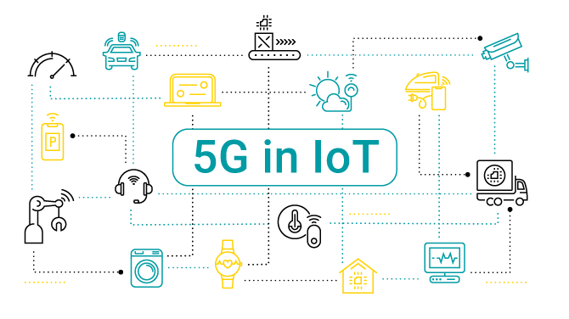
Future Opportunities/ Challenges
AI and Machine Learning Integration
Advanced neural networks
Predictive analytics
Deep learning for multi-camera surveillance
Advanced Infrastructure
5G and IoT sensor integration
Edge computing for reduced latency
Cloud-based scalable solutions
Real-time data processing capabilities
Enhanced Analytics Capabilities
Predictive maintenance systems
Pattern recognition improvements
Behavioral analysis integration
Cross-system data correlation

Slide 13


Future Opportunities/ Challenges
POTENTIAL CHALLENGES
Technical Challenges:
Data privacy and security concerns
System scalability issues
Integration with legacy systems
Real-time processing bottlenecks
Operational Challenges:
High initial implementation costs
Staff training requirements
System maintenance needs
Regulatory compliance

Slide 14
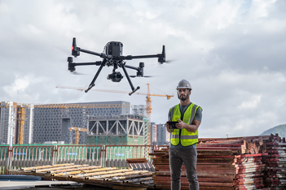
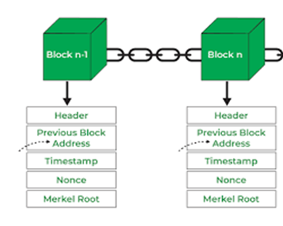
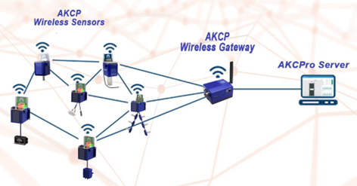

Future Opportunities/ Challenges
TECHNICAL IMPACTS
Short-term (1-2 years):
Edge Computing:
Faster processing at source
Reduced data transmission needs
Improved response times
Advanced Sensors:
Higher accuracy in detection
Better environmental monitoring
Improved data collection
Long-term (3-5 years):
Autonomous Systems:
Self-monitoring infrastructure
Automated response mechanisms
Blockchain Integration:
Secure data sharing
Transparent incident recording
Quantum Computing:
Complex pattern analysis
Advanced prediction models

Slide 15
References
Afandizadeh, Shahriar, et al. “Deep Learning Algorithms for Traffic Forecasting: A Comprehensive Review and Comparison with Classical Ones.” Journal of Advanced Transportation, vol. 2024, no. 1, Jan. 2024, https://doi.org/10.1155/2024/9981657.
Santos, Daniel, et al. “Machine Learning Approaches to Traffic Accident Analysis and Hotspot Prediction.” Computers, vol. 10, no. 12, 24 Nov. 2021, p. 157, https://doi.org/10.3390/computers10120157.
Karau, H., Konwinski, A., Wendell, P., & Zaharia, M. (2015). Learning Spark: Lightning-Fast Big Data Analysis. “O’Reilly Media, Inc.”
Gomes, B., Coelho, J., & Aidos, H. (2023). A survey on traffic flow prediction and classification. Intelligent Systems With Applications, 20, 200268. https://doi.org/10.1016/j.iswa.2023.200268
Computer Vision: Algorithms and Applications, 2nd ed. (n.d.). https://szeliski.org/Book/
Car Crash Dataset (CCD). (2022, July 5). Kaggle. https://www.kaggle.com/datasets/asefjamilajwad/car-crash-dataset-ccd
Powell, B. (2018). Mastering Microsoft Power Bi. Packt Publishing.
Documentation | Apache Spark. (n.d.). https://spark.apache.org/documentation.html

Slide 16
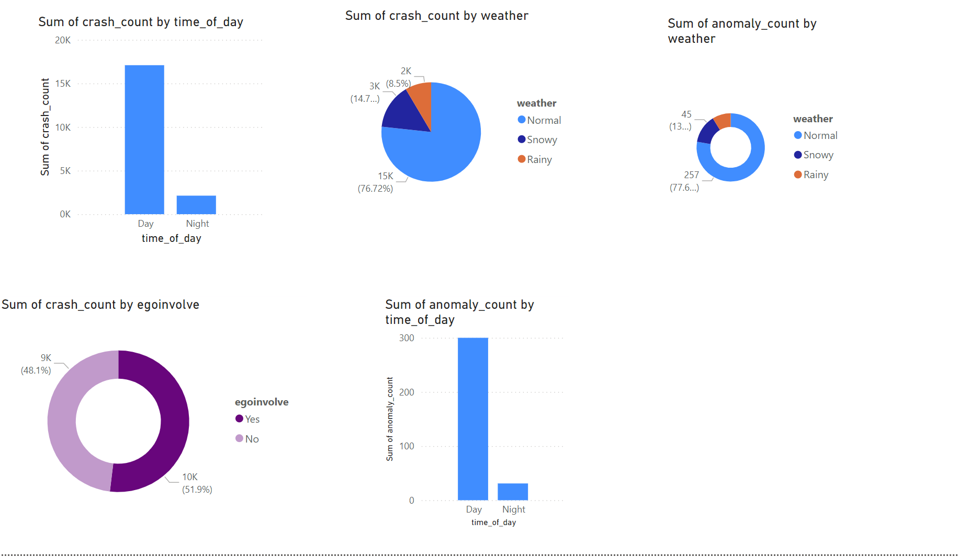
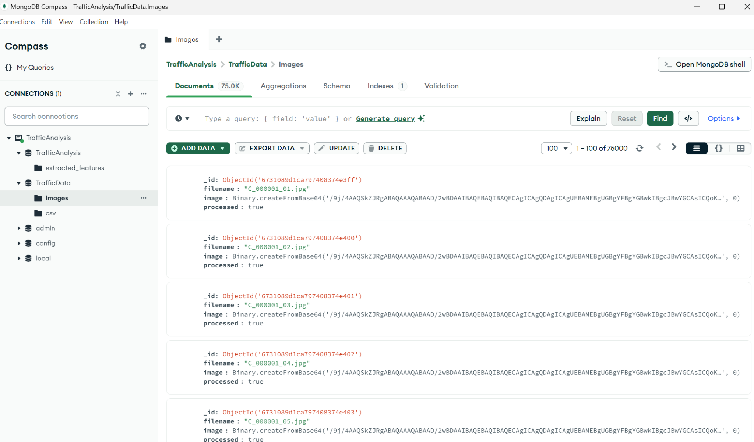
Technical Work
Demonstrations:
MongoDB:Helped in data storage efficiency.
Spark Code: Feature extraction and crash analysis helped process large-scale data.
Power BI: Finalized visual reports.
GitHub Repository: Link: Car_Crash_Final_Project

Slide 17
Thank You!
QUESTIONS?

